Slide 1
Revision – Probability
Miss L
Year 8

Slide 2
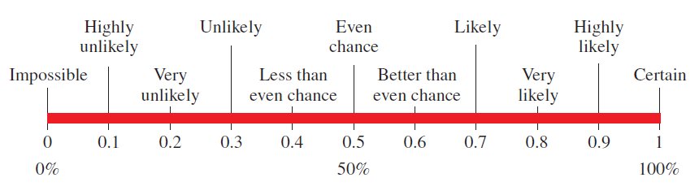
Is defined as the chance of an event occurring
Probability may be written as percentages, decimals and fractions
A scale is used to allocate the probability of an event
What is Probability?

Slide 3

Theoretical Probability
What is Theoretical Probability?
based as a faction of the number of favourable outcomes to the number of possible outcomes.

Slide 4
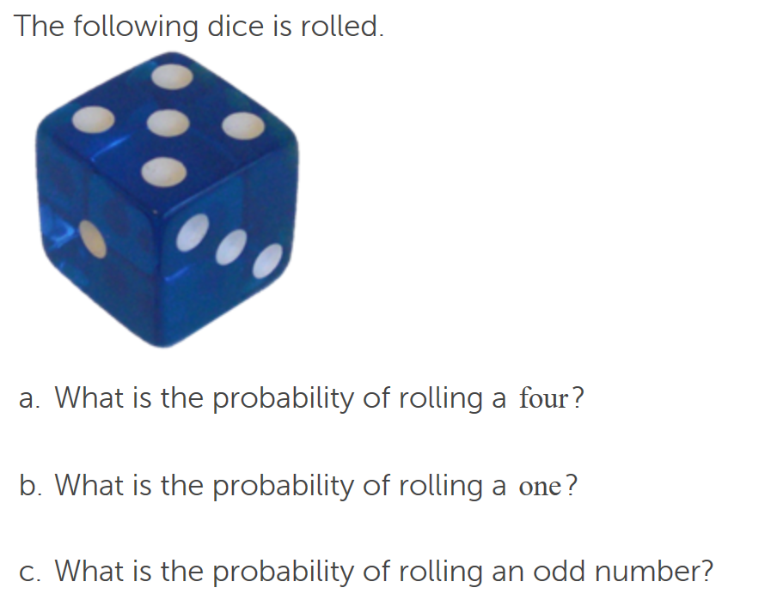
Theoretical Probability

Slide 5

Experimental Probability
Theoretical probability is what we expect to happen
Experimental probability is what actually happens when we try it out.

Slide 6
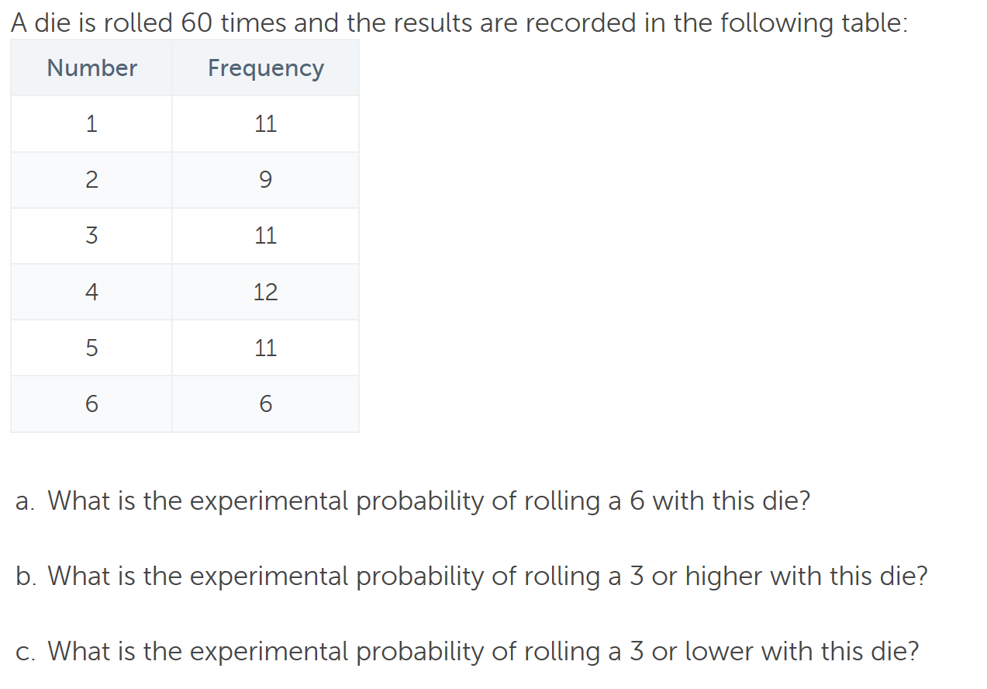
Experimental Probability

Slide 7
Complementary Probability
Complement means an event not happening
The complement of having long hair is the not having long hair.
The complement of event A is not event A which can be written as A’
Not A = A’
The sum of the probability of an event and its complete is 1
P(A) + P(A’) = 1
Therefor P(A’) = 1 - P(A)

Slide 8
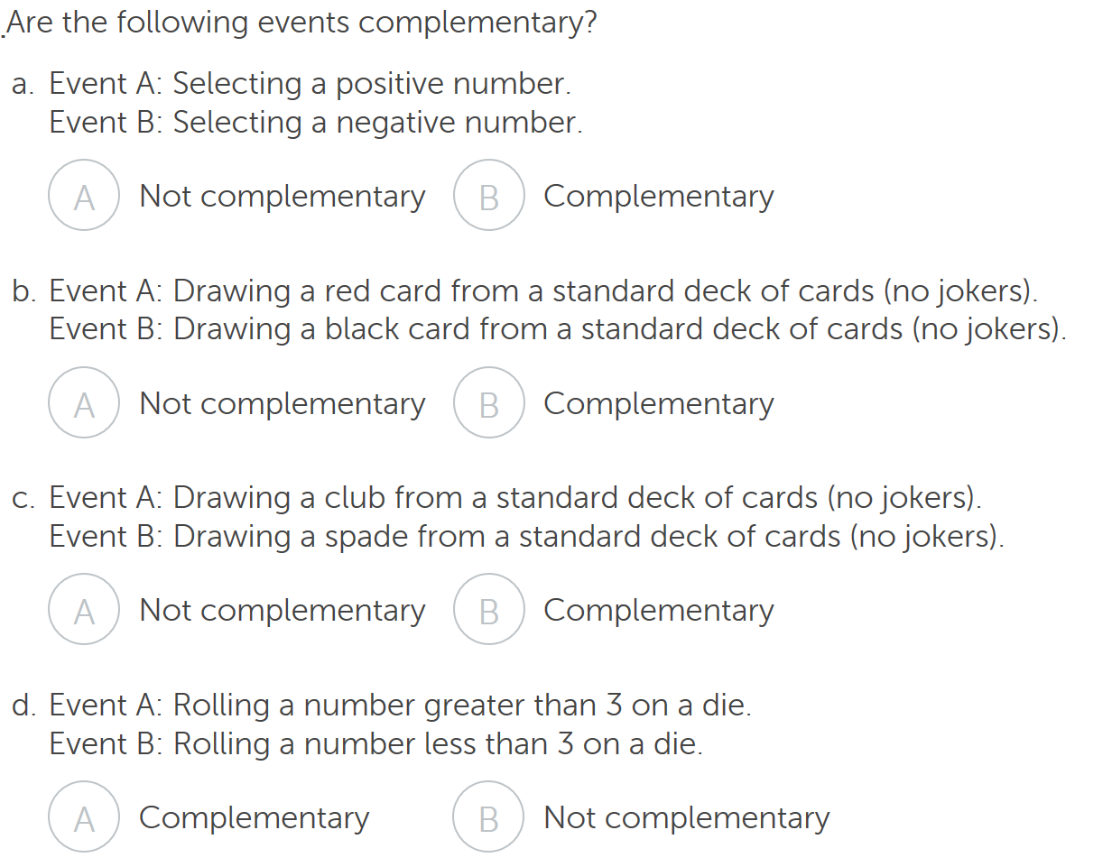
Complementary Probability

Slide 9
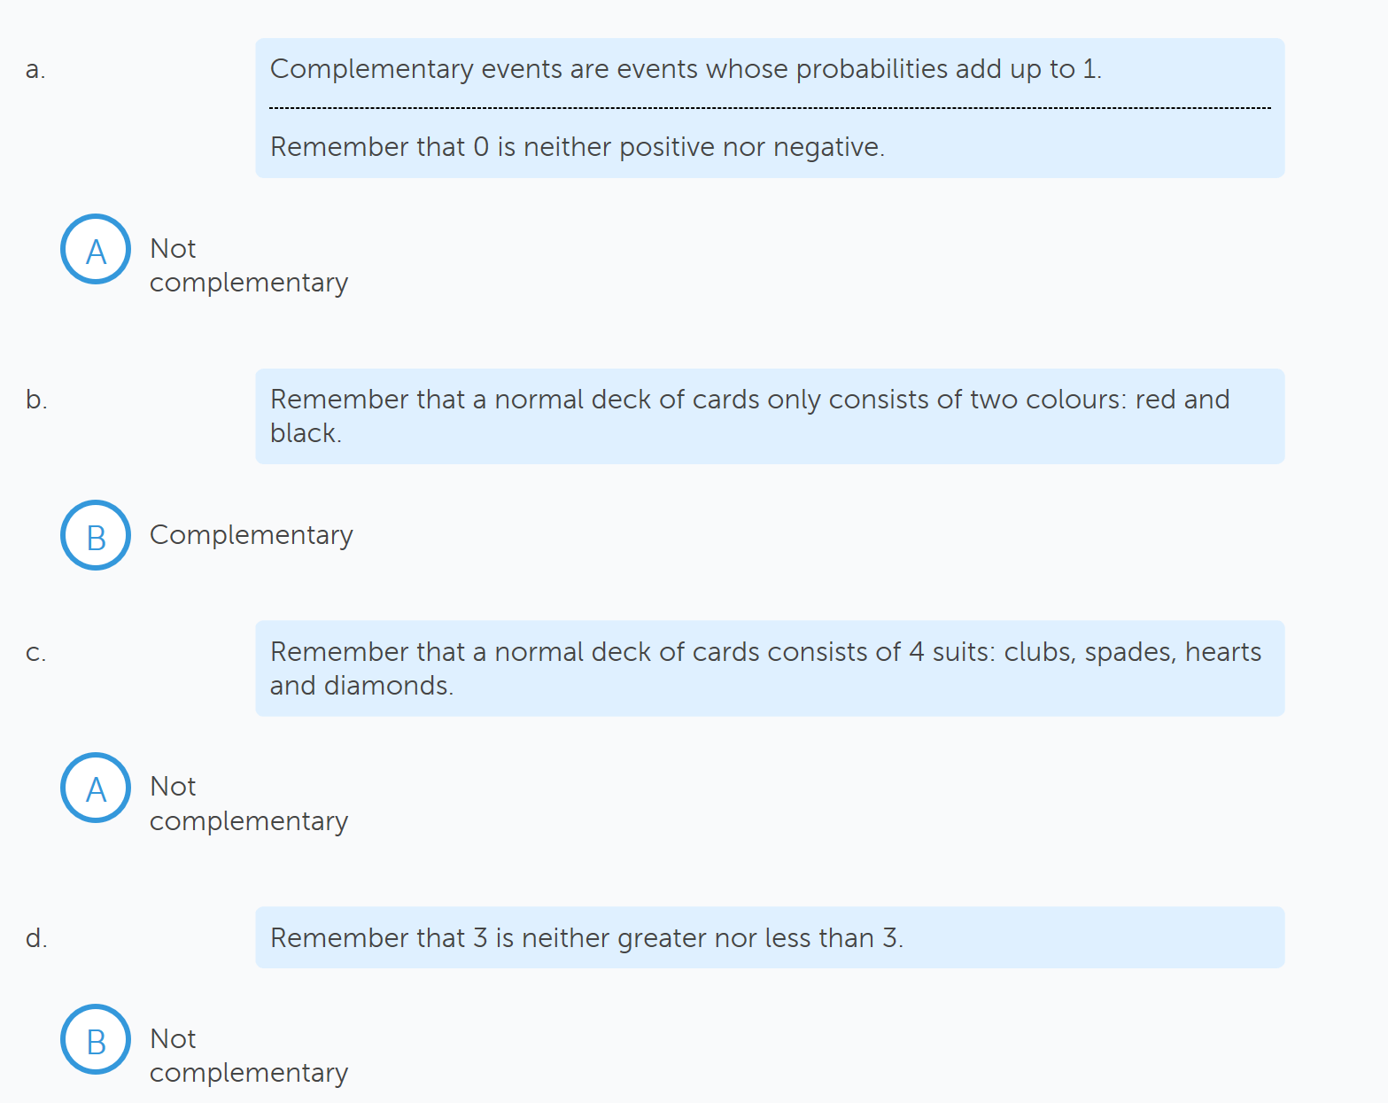

Slide 10
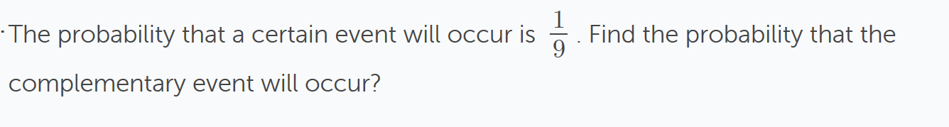

Slide 11
